Slide 1
Learning Optimal Strategy in Multi-Agent Alternating Turn Board-and-Card Games
Adithya Raam Sankar and Nihal S Soans

Slide 2
Overview
What we are doing?
Is it a good problem?
Why is it a good problem?
How do we solve the problem?
Is the solution good enough?
Can we see it work?
How can we improve further?

Slide 3
Problem Statement
Board-and-card games are those which involve higher level of uncertainty as it includes the probability of getting the right card and the moves made by other players. We look to model such games as Markov Games and find an optimal policy through the Minimax – Q algorithm. This will also be a test for the Minimax – Q algorithm to check how it performs in a situation with multiple goal states.

Slide 4
Board and Card Games
Board-and-card games don’t have a single undominated policy
Next action always depends on the opponent’s move
Stochastic due to:
Nature of the random card draw
Defend a potential loss
Markov games as a model to learn the optimal strategy

Slide 5
Sequence
We will consider a simplified game of Sequence for evaluation of the algorithms
The game consists of 2 players with alternating turns
Single deck of 52 cards with a position on the board corresponding to every card except Jacks
For each turn, the player will have 5 cards on hand to choose from
The goal is to capture 5 consecutive board positions

Slide 6
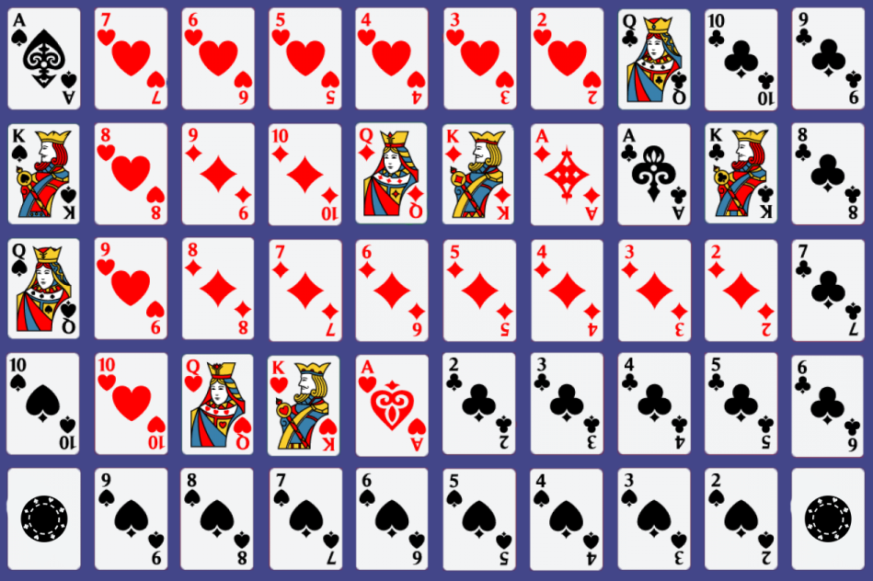
The Board

Slide 7


The Board

Slide 8
The Board

Slide 9
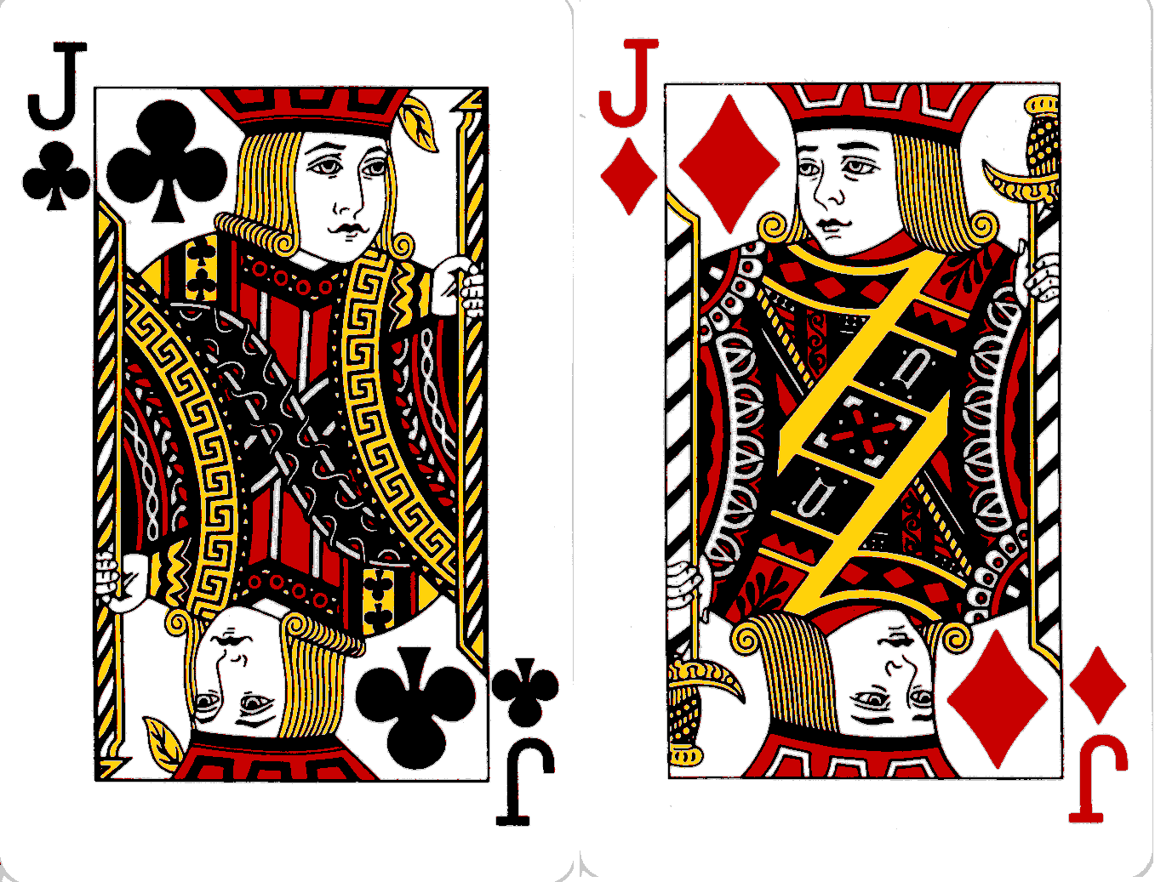
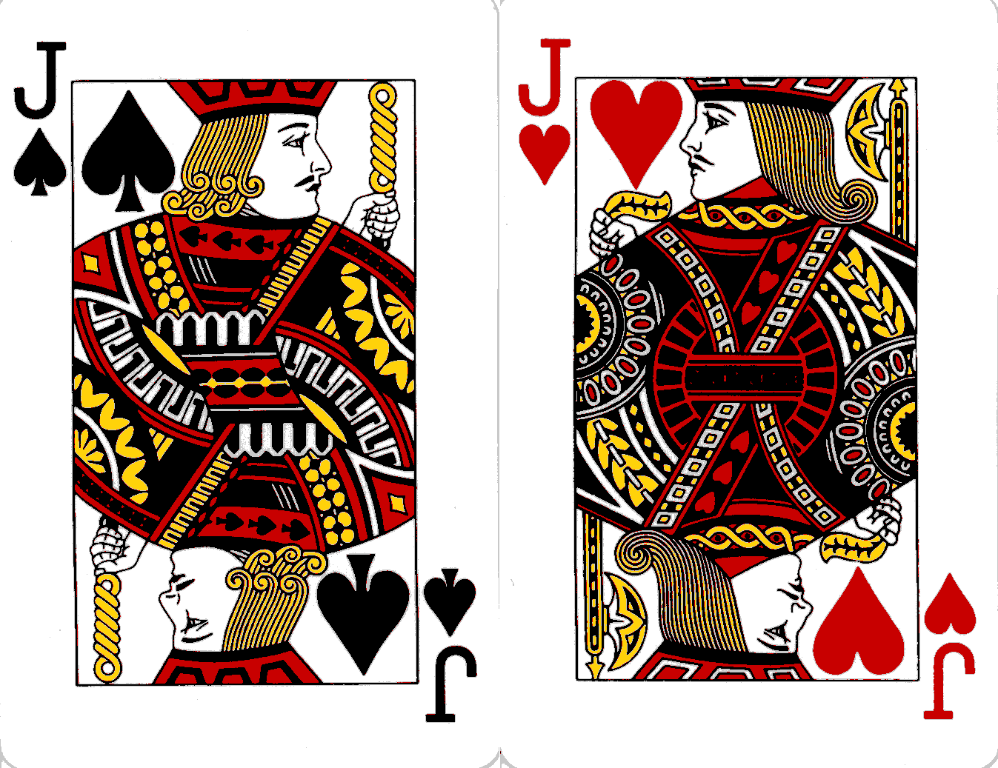
Jacks
TWO Eyed
ONE eyed

Slide 10
The Board

Slide 11
Markov Definition
S is the set of possible states <s₁,s₂,…s_{t}> indicating the location of each player’s coins on the board and the current hand of the player
A is the set of actions i.e the playable moves for the current set of cards in the hand
R is the reward function for that board state for each action
R: S x A → R
_____G_________B_GB___G____________B______________-
7 of Spades,7 of Hearts,Jack of Diamonds,8 of Hearts,9 of Hearts|7 of Hearts : 1.999998

Slide 12
Reward at 2 Clubs

Slide 13
Approach
Python as the language for the code
Sequence simulator was coded ground up
Will be using PyDealer, which is a simple to use Python package for “simulating” decks of standard playing cards for dealing the cards.
PyGame was used for the simulator

Slide 14
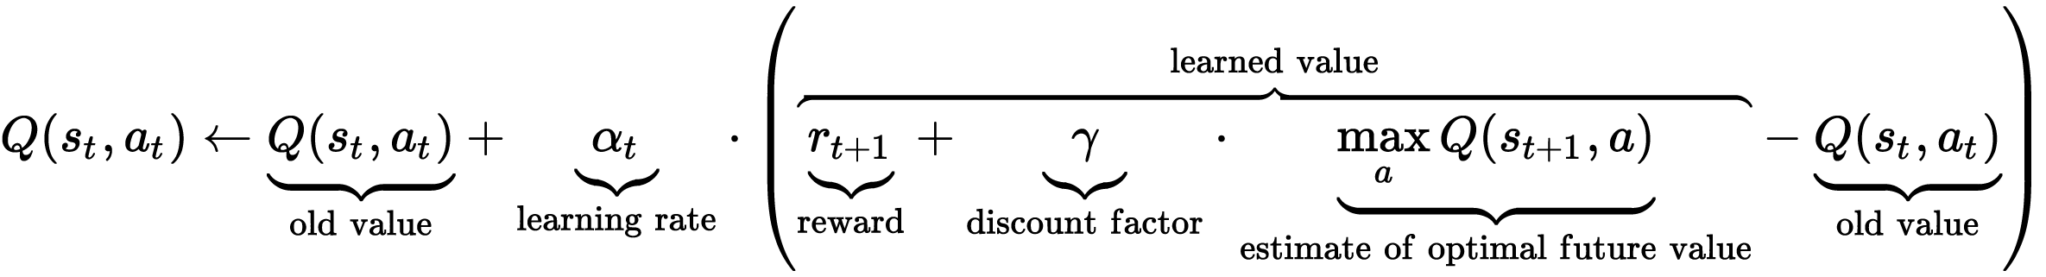
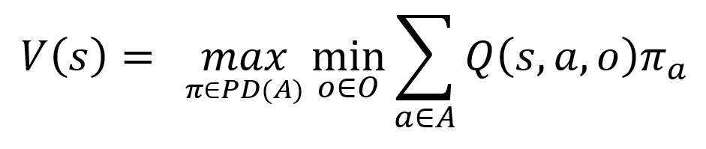
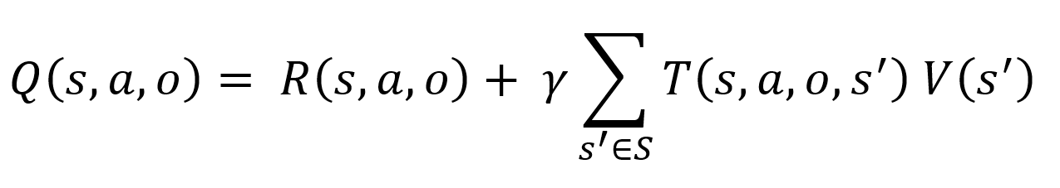
Algorithm
Q – Learning
Minimax – Q Learning

Slide 15
Types of Games
Games were played between different algorithms:
Q – Algorithm vs Random
Q – Algorithm vs Q -Algorithm
Minimax Q vs Minimax Q
Minimax Q vs Random
Training time – 1000 Games
Testing time – 100 Games

Slide 16
Results
Player 1 Player 2 | Random | QQ | MM
Random | 55% | 68% | 79%
QQ | 32% | 62% | 77%
MM | 21% | 23% | 52%

Slide 17

Demonstration

Slide 18
Research Opportunities
Multiple competing players
Team scenarios
Bigger Board with 2 Decks
Search deeper in MiniMax tree
Explore other algorithmic approaches
Implement Jack moves intelligently
Learn by playing against humans

Slide 19
References
Christopher J. C. H. Watkins and Peter Dayan. Q-learning. Machine Learning, 3:279–292, 1992
M. Littman, "Markov Games as a Framework for Multiagent Reinforcement Learning", International Conference on Machine Learning, pp. 157-163, 1994
Marco Block, et al. "Using reinforcement learning in chess engines." Research in Computing Science 35 (2008): 31-40.
Hajime Fujita, et al. “A reinforcement learning scheme for a multi-agent card game“, IEEE International Conference on Systems, Man, and Cybernetics, 2003
Jakobsson, Tonie, and John Persson. "Self-learning Game Player–Connect-4 with Q-learning." (2011).
Dahl, Fredrik A. "A reinforcement learning algorithm applied to simplified two-player Texas Hold’em poker." European Conference on Machine Learning. Springer Berlin Heidelberg, 2001.

